Slide 1
Chapter 9 - Object-Oriented Programming
Outline
9.1 Introduction
9.2 Superclasses and Subclasses
9.3 protected Members
9.4 Relationship between Superclass Objects and Subclass Objects
9.5 Constructors and Finalizers in Subclasses
9.6 Implicit Subclass-Object-to-Superclass-Object Conversion
9.7 Software Engineering with Inheritance
9.8 Composition vs. Inheritance
9.9 Case Study: Point, Circle, Cylinder
9.10 Introduction to Polymorphism
9.11 Type Fields and switch Statements
9.12 Dynamic Method Binding
9.13 final Methods and Classes

Slide 2
Chapter 9 - Object-Oriented Programming
9.14 Abstract Superclasses and Concrete Classes
9.15 Polymorphism Examples
9.16 Case Study: A Payroll System Using Polymorphism
9.17 New Classes and Dynamic Binding
9.18 Case Study: Inheriting Interface and Implementation
9.19 Case Study: Creating and Using Interfaces
9.20 Inner Class Definitions
9.21 Notes on Inner Class Definitions
9.22 Type-Wrapper Classes for Primitive Types
9.23 (Optional Case Study) Thinking About Objects: Incorporating Inheritance into the Elevator Simulation
9.24 (Optional) Discovering Design Patterns: Introducing Creational, Structural and Behavioral Design Patterns

Slide 3
9.1 Introduction
Object-oriented programming
  Inheritance
    Software reusability
    Classes are created from existing ones
      Absorbing attributes and behaviors
      Adding new capabilities
      Convertible inherits from Automobile
  Polymorphism
    Enables developers to write programs in general fashion
      Handle variety of existing and yet-to-be-specified classes
    Helps add new capabilities to system

Slide 4
9.1 Introduction (cont.)
Object-oriented programming
  Inheritance
    Subclass inherits from superclass
      Subclass usually adds instance variables and methods
    Single vs. multiple inheritance
      Java does not support multiple inheritance
        Interfaces (discussed later) achieve the same effect
    “Is a” relationship
  Composition
    “Has a” relationship

Slide 5
9.2 Superclasses and Subclasses
“Is a” Relationship
  Object “is an” object of another class
    Rectangle “is a” quadrilateral
      Class Rectangle inherits from class Quadrilateral
  Form tree-like hierarchical structures

Slide 6
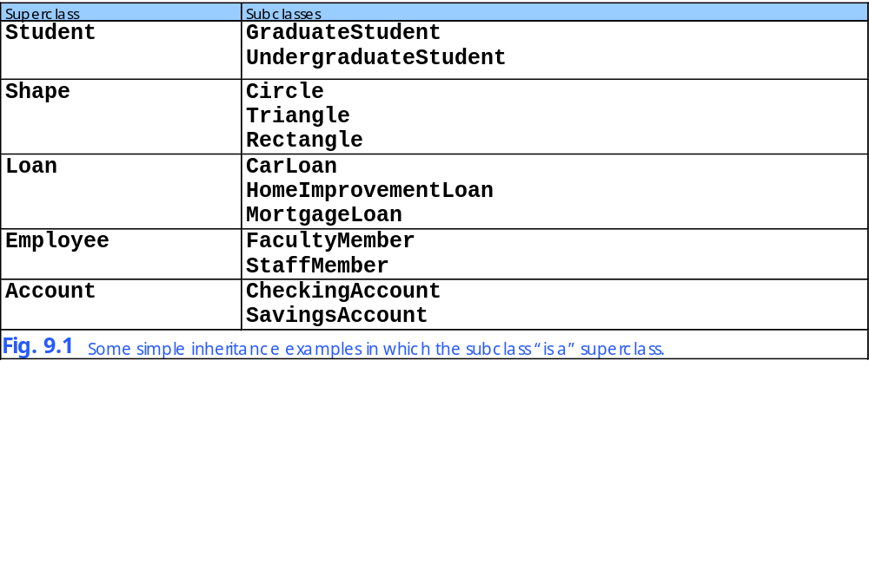

Slide 7
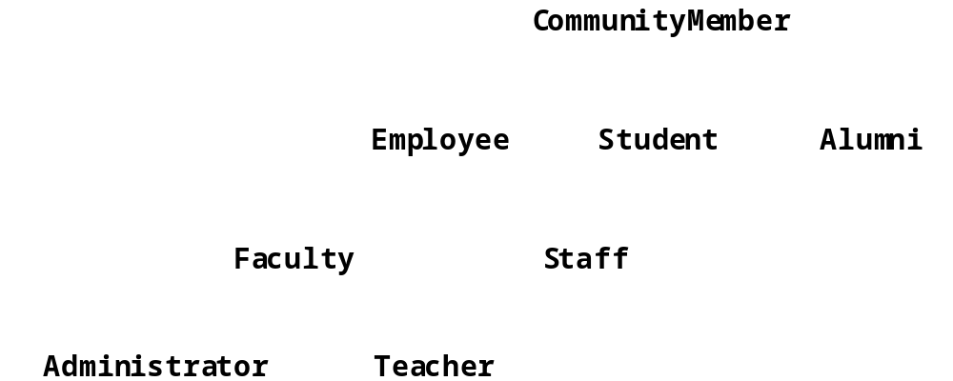
Fig. 9.2 An inheritance hierarchy for university CommunityMembers.
CommunityMember is a direct superclass of Employee
CommunityMember is an indirect superclass of Faculty

Slide 8
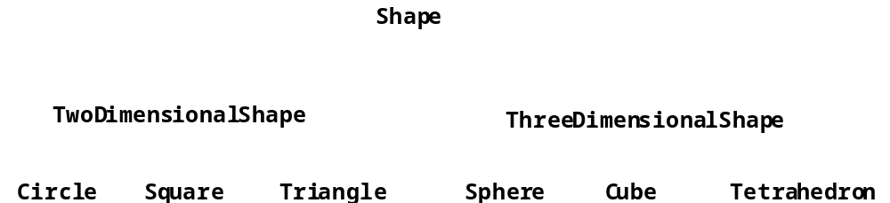
Fig. 9.3 A portion of a Shape class hierarchy.

Slide 9
9.3 protected Members
protected access members
  Between public and private in protection
  Accessed only by
    Superclass methods
    Subclass methods
    Methods of classes in same package
      package access

Slide 10
9.4 Relationship between Superclass Objects and Subclass Objects
Subclass object
  Can be treated as superclass object
    Reverse is not true
      Shape is not always a Circle
  Every class implicitly extends java.lang.Object
    Unless specified otherwise in class definition’s first line

Slide 11
Point.java
Line 5 protected members prevent clients from direct access (unless clients are Point subclasses or are in same package)
1 // Fig. 9.4: Point.java
2 // Definition of class Point
3
4 public class Point {
5 protected int x, y; // coordinates of Point
6
7 // No-argument constructor
8 public Point()
9 {
10 // implicit call to superclass constructor occurs here
11 setPoint( 0, 0 );
12 }
13
14 // constructor
15 public Point( int xCoordinate, int yCoordinate )
16 {
17 // implicit call to superclass constructor occurs here
18 setPoint( xCoordinate, yCoordinate );
19 }
20
21 // set x and y coordinates of Point
22 public void setPoint( int xCoordinate, int yCoordinate )
23 {
24 x = xCoordinate;
25 y = yCoordinate;
26 }
27
28 // get x coordinate
29 public int getX()
30 {
31 return x;
32 }
33
protected members prevent clients from direct access (unless clients are Point subclasses or are in same package)

Slide 12
Point.java
34 // get y coordinate
35 public int getY()
36 {
37 return y;
38 }
39
40 // convert into a String representation
41 public String toString()
42 {
43 return "[" + x + ", " + y + "]";
44 }
45
46 } // end class Point

Slide 13
Circle.java
Line 4
Circle is a Point subclass
Line 4
Circle inherits Point’s protected variables and public methods (except for constuctor)
Line 10
Implicit call to Point constructor
Line 19
Explicit call to Point constructor using super
1 // Fig. 9.5: Circle.java
2 // Definition of class Circle
3
4 public class Circle extends Point { // inherits from Point
5 protected double radius;
6
7 // no-argument constructor
8 public Circle()
9 {
10 // implicit call to superclass constructor occurs here
11 setRadius( 0 );
12 }
13
14 // constructor
15 public Circle( double circleRadius, int xCoordinate,
16 int yCoordinate )
17 {
18 // call superclass constructor to set coordinates
19 super( xCoordinate, yCoordinate );
20
21 // set radius
22 setRadius( circleRadius );
23 }
24
25 // set radius of Circle
26 public void setRadius( double circleRadius )
27 {
28 radius = ( circleRadius >= 0.0 ? circleRadius : 0.0 );
29 }
30
Circle is a Point subclass
Circle inherits Point’s protected variables and public methods (except for constuctor)
Implicit call to Point constructor
Explicit call to Point constructor using super

Slide 14
Circle.java
Lines 44-48
Override method toString of class Point by using same signature
31 // get radius of Circle
32 public double getRadius()
33 {
34 return radius;
35 }
36
37 // calculate area of Circle
38 public double area()
39 {
40 return Math.PI * radius * radius;
41 }
42
43 // convert the Circle to a String
44 public String toString()
45 {
46 return "Center = " + "[" + x + ", " + y + "]" +
47 "; Radius = " + radius;
48 }
49
50 } // end class Circle
Override method toString of class Point by using same signature

Slide 15
InheritanceTest.java
Lines 18-19
Instantiate objects
Line 22
Circle invokes method toString
Line 26
Superclass object references subclass
Line 29
Point invokes Circle’s toString method
Line 33
Downcast Point to Circle
1 // Fig. 9.6: InheritanceTest.java
2 // Demonstrating the "is a" relationship
3
4 // Java core packages
5 import java.text.DecimalFormat;
6
7 // Java extension packages
8 import javax.swing.JOptionPane;
9
10 public class InheritanceTest {
11
12 // test classes Point and Circle
13 public static void main( String args[] )
14 {
15 Point point1, point2;
16 Circle circle1, circle2;
17
18 point1 = new Point( 30, 50 );
19 circle1 = new Circle( 2.7, 120, 89 );
20
21 String output = "Point point1: " + point1.toString() +
22 "\nCircle circle1: " + circle1.toString();
23
24 // use "is a" relationship to refer to a Circle
25 // with a Point reference
26 point2 = circle1; // assigns Circle to a Point reference
27
28 output += "\n\nCircle circle1 (via point2 reference): " +
29 point2.toString();
30
31 // use downcasting (casting a superclass reference to a
32 // subclass data type) to assign point2 to circle2
33 circle2 = ( Circle ) point2;
34
Instantiate Point and Circle objects
Circle invokes its overridden toString method
Superclass object can reference subclass object
Point still invokes Circle’s overridden toString method
Downcast Point to Circle

Slide 16
InheritanceTest.java
Line 36
Circle invokes its overridden toString method
Line 40
Circle invokes method area
Line 43
Use instanceof to determine if Point refers to Circle
Line 44
If Point refers to Circle, cast Point as Circle
Circle invokes its overridden toString method
35 output += "\n\nCircle circle1 (via circle2): " +
36 circle2.toString();
37
38 DecimalFormat precision2 = new DecimalFormat( "0.00" );
39 output += "\nArea of c (via circle2): " +
40 precision2.format( circle2.area() );
41
42 // attempt to refer to Point object with Circle reference
43 if ( point1 instanceof Circle ) {
44 circle2 = ( Circle ) point1;
45 output += "\n\ncast successful";
46 }
47 else
48 output += "\n\npoint1 does not refer to a Circle";
49
50 JOptionPane.showMessageDialog( null, output,
51 "Demonstrating the \"is a\" relationship",
52 JOptionPane.INFORMATION_MESSAGE );
53
54 System.exit( 0 );
55 }
56
57 } // end class InheritanceTest
Circle invokes method area
Use instanceof to determine if Point refers to Circle
If Point refers to Circle, cast Point as Circle

Slide 17
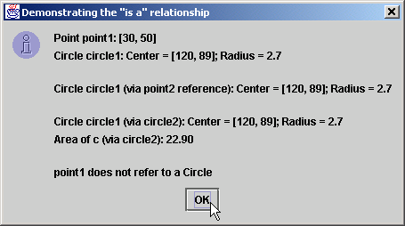
Fig. 9.6 Assigning subclass references to superclass references

Slide 18
9.5 Constructors and Finalizers in Subclasses
Superclass constructor
  Initializes superclass instance variables of subclass
  Not inherited by subclass
  Called by subclass
    Implicitly or explicitly with super reference

Slide 19
9.5 Constructors and Finalizers in Subclasses (cont.)
finalize method
  Garbage collection
  Subclass finalize method
    should invoke superclass finalize method

Slide 20
Point.java
Lines 7-20
Superclass constructors
Lines 23-26
Superclass finalize method uses protected for subclass access, but not for other clients
1 // Fig. 9.7: Point.java
2 // Definition of class Point
3 public class Point extends Object {
4 protected int x, y; // coordinates of the Point
5
6 // no-argument constructor
7 public Point()
8 {
9 x = 0;
10 y = 0;
11 System.out.println( "Point constructor: " + this );
12 }
13
14 // constructor
15 public Point( int xCoordinate, int yCoordinate )
16 {
17 x = xCoordinate;
18 y = yCoordinate;
19 System.out.println( "Point constructor: " + this );
20 }
21
22 // finalizer
23 protected void finalize()
24 {
25 System.out.println( "Point finalizer: " + this );
26 }
27
28 // convert Point into a String representation
29 public String toString()
30 {
31 return "[" + x + ", " + y + "]";
32 }
33
34 } // end class Point
Superclass constructors
Superclass finalize method uses protected for subclass access, but not for other clients

Slide 21
Circle.java
Line 9
Implicit call to Point constructor
Line 19
Explicit call to Point constructor using super
Lines 26-30
Override Point’s method finalize, but call it using super
1 // Fig. 9.8: Circle.java
2 // Definition of class Circle
3 public class Circle extends Point { // inherits from Point
4 protected double radius;
5
6 // no-argument constructor
7 public Circle()
8 {
9 // implicit call to superclass constructor here
10 radius = 0;
11 System.out.println( "Circle constructor: " + this );
12 }
13
14 // Constructor
15 public Circle( double circleRadius, int xCoordinate,
16 int yCoordinate )
17 {
18 // call superclass constructor
19 super( xCoordinate, yCoordinate );
20
21 radius = circleRadius;
22 System.out.println( "Circle constructor: " + this );
23 }
24
25 // finalizer
26 protected void finalize()
27 {
28 System.out.println( "Circle finalizer: " + this );
29 super.finalize(); // call superclass finalize method
30 }
31
Implicit call to Point constructor
Explicit call to Point constructor using super
Override Point’s method finalize, but call it using super

Slide 22
Circle.java
32 // convert the Circle to a String
33 public String toString()
34 {
35 return "Center = " + super.toString() +
36 "; Radius = " + radius;
37 }
38
39 } // end class Circle

Slide 23
Test.java
Lines 10-11
Instantiate Circle objects
Line 17
Invoke Circle’s method finalize by calling System.gc
1 // Fig. 9.9: Test.java
2 // Demonstrate when superclass and subclass
3 // constructors and finalizers are called.
4 public class Test {
5
6 // test when constructors and finalizers are called
7 public static void main( String args[] )
8 {
9 Circle circle1, circle2;
10
11 circle1 = new Circle( 4.5, 72, 29 );
12 circle2 = new Circle( 10, 5, 5 );
13
14 circle1 = null; // mark for garbage collection
15 circle2 = null; // mark for garbage collection
16
17 System.gc(); // call the garbage collector
18 }
19
20 } // end class Test
Instantiate Circle objects
Invoke Circle’s method finalize by calling System.gc
Point constructor: Center = [72, 29]; Radius = 0.0
Circle constructor: Center = [72, 29]; Radius = 4.5
Point constructor: Center = [5, 5]; Radius = 0.0
Circle constructor: Center = [5, 5]; Radius = 10.0
Circle finalizer: Center = [72, 29]; Radius = 4.5
Point finalizer: Center = [72, 29]; Radius = 4.5
Circle finalizer: Center = [5, 5]; Radius = 10.0
Point finalizer: Center = [5, 5]; Radius = 10.0

Slide 24
9.6 Implicit Subclass-Object-to-Superclass-Object Conversion
Superclass reference and subclass reference
  Implicit conversion
    Subclass reference to superclass reference
      Subclass object “is a” superclass object
  Four ways to mix and match references
    Refer to superclass object with superclass reference
    Refer to subclass object with subclass reference
    Refer to subclass object with superclass reference
      Can refer only to superclass members
    Refer to superclass object with subclass reference
      Syntax error

Slide 25
9.7 Software Engineering with Inheritance
Inheritance
  Create class (subclass) from existing one (superclass)
    Subclass creation does not affect superclass
  New class inherits attributes and behaviors
  Software reuse

Slide 26
9.8 Composition vs. Inheritance
Inheritance
  “Is a” relationship
  Teacher is an Employee
Composition
  “Has a” relationship
  Employee has a TelephoneNumber

Slide 27
9.9 Case Study: Point, Cylinder, Circle
Consider point, circle, cylinder hierarchy
  Point is superclass
  Circle is Point subclass
  Cylinder is Circle subclass

Slide 28
Point.java
Line 6 protected members prevent clients from direct access (unless clients are Point subclasses or are in same package)
Lines 9-20
Constructor and overloaded constructor
1 // Fig. 9.10: Point.java
2 // Definition of class Point
3 package com.deitel.jhtp4.ch09;
4
5 public class Point {
6 protected int x, y; // coordinates of Point
7
8 // No-argument constructor
9 public Point()
10 {
11 // implicit call to superclass constructor occurs here
12 setPoint( 0, 0 );
13 }
14
15 // constructor
16 public Point( int xCoordinate, int yCoordinate )
17 {
18 // implicit call to superclass constructor occurs here
19 setPoint( xCoordinate, yCoordinate );
20 }
21
22 // set x and y coordinates of Point
23 public void setPoint( int xCoordinate, int yCoordinate )
24 {
25 x = xCoordinate;
26 y = yCoordinate;
27 }
28
29 // get x coordinate
30 public int getX()
31 {
32 return x;
33 }
34
protected members prevent clients from direct access (unless clients are Point subclasses or are in same package)
Constructor and overloaded constructor

Slide 29
Point.java
35 // get y coordinate
36 public int getY()
37 {
38 return y;
39 }
40
41 // convert into a String representation
42 public String toString()
43 {
44 return "[" + x + ", " + y + "]";
45 }
46
47 } // end class Point

Slide 30
Test.java
Line 15
Instantiate Point object
Lines 18-19
Methods getX and getY read Point’s protected variables
1 // Fig. 9.11: Test.java
2 // Applet to test class Point
3
4 // Java extension packages
5 import javax.swing.JOptionPane;
6
7 // Deitel packages
8 import com.deitel.jhtp4.ch09.Point;
9
10 public class Test {
11
12 // test class Point
13 public static void main( String args[] )
14 {
15 Point point = new Point( 72, 115 );
16
17 // get coordinates
18 String output = "X coordinate is " + point.getX() +
19 "\nY coordinate is " + point.getY();
20
21 // set coordinates
22 point.setPoint( 10, 10 );
23
24 // use implicit call to point.toString()
25 output += "\n\nThe new location of point is " + point;
26
27 JOptionPane.showMessageDialog( null, output,
28 "Demonstrating Class Point",
29 JOptionPane.INFORMATION_MESSAGE );
30
31 System.exit( 0 );
32 }
33
34 } // end class Test
Instantiate Point object
Methods getX and getY read Point’s protected variables

Slide 31
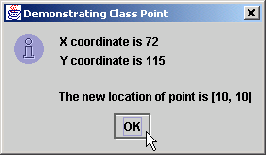
Fig. 9.11 Testing class Point

Slide 32
Circle.java
Line 5
Circle is a Point subclass
Line 5
Circle inherits Point’s protected variables and public methods (except for constuctor)
Line 11
Implicit call to Point constructor
Line 20 explicit call to Point constructor using super
1 // Fig. 9.12: Circle.java
2 // Definition of class Circle
3 package com.deitel.jhtp4.ch09;
4
5 public class Circle extends Point { // inherits from Point
6 protected double radius;
7
8 // no-argument constructor
9 public Circle()
10 {
11 // implicit call to superclass constructor occurs here
12 setRadius( 0 );
13 }
14
15 // constructor
16 public Circle( double circleRadius, int xCoordinate,
17 int yCoordinate )
18 {
19 // call superclass constructor to set coordinates
20 super( xCoordinate, yCoordinate );
21
22 // set radius
23 setRadius( circleRadius );
24 }
25
26 // set radius of Circle
27 public void setRadius( double circleRadius )
28 {
29 radius = ( circleRadius >= 0.0 ? circleRadius : 0.0 );
30 }
31
Circle is a Point subclass
Circle inherits Point’s protected variables and public methods (except for constuctor)
Implicit call to Point constructor
Explicit call to Point constructor using super

Slide 33
Circle.java
32 // get radius of Circle
33 public double getRadius()
34 {
35 return radius;
36 }
37
38 // calculate area of Circle
39 public double area()
40 {
41 return Math.PI * radius * radius;
42 }
43
44 // convert the Circle to a String
45 public String toString()
46 {
47 return "Center = " + "[" + x + ", " + y + "]" +
48 "; Radius = " + radius;
49 }
50
51 } // end class Circle

Slide 34
Test.java
Line 19
Instantiate Circle object
Lines 25 and 28
Calls to methods getRadius and setRadius read and manipulate Circle’s protected variables
Lines 23-24 and 29 Calls to methods getX, getY and setPoint read and manipulate Circle’s inherited protected variables
1 // Fig. 9.13: Test.java
2 // Applet to test class Circle
3
4 // Java core packages
5 import java.text.DecimalFormat;
6
7 // Java extension packages
8 import javax.swing.JOptionPane;
9
10 // Deitel packages
11 import com.deitel.jhtp4.ch09.Circle;
12
13 public class Test {
14
15 // test class Circle
16 public static void main( String args[] )
17 {
18 // create a Circle
19 Circle circle = new Circle( 2.5, 37, 43 );
20 DecimalFormat precision2 = new DecimalFormat( "0.00" );
21
22 // get coordinates and radius
23 String output = "X coordinate is " + circle.getX() +
24 "\nY coordinate is " + circle.getY() +
25 "\nRadius is " + circle.getRadius();
26
27 // set coordinates and radius
28 circle.setRadius( 4.25 );
29 circle.setPoint( 2, 2 );
30
31 // get String representation of Circle and calculate area
32 output +=
33 "\n\nThe new location and radius of c are\n" + circle +
34 "\nArea is " + precision2.format( circle.area() );
35
Instantiate Circle object
Calls to methods getRadius and setRadius read and manipulate Circle’s protected variables
Calls to methods getX, getY and setPoint read and manipulate Circle’s inherited protected variables

Slide 35
Test.java
36 JOptionPane.showMessageDialog( null, output,
37 "Demonstrating Class Circle",
38 JOptionPane.INFORMATION_MESSAGE );
39
40 System.exit( 0 );
41 }
42
43 } // end class Test

Slide 36
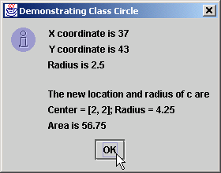
Fig. 9.13 Testing class Circle

Slide 37
Cylinder.java
Line 5
Cylinder is a Circle subclass
Line 5
Cylinder inherits Point’s and Circle’s protected variables and public methods (except for constuctors)
Line 11
Implicit call to Circle constructor
Line 20
Explicit call to Circle constructor using super
1 // Fig. 9.14: Cylinder.java
2 // Definition of class Cylinder
3 package com.deitel.jhtp4.ch09;
4
5 public class Cylinder extends Circle {
6 protected double height; // height of Cylinder
7
8 // no-argument constructor
9 public Cylinder()
10 {
11 // implicit call to superclass constructor here
12 setHeight( 0 );
13 }
14
15 // constructor
16 public Cylinder( double cylinderHeight, double cylinderRadius,
17 int xCoordinate, int yCoordinate )
18 {
19 // call superclass constructor to set coordinates/radius
20 super( cylinderRadius, xCoordinate, yCoordinate );
21
22 // set cylinder height
23 setHeight( cylinderHeight );
24 }
25
26 // set height of Cylinder
27 public void setHeight( double cylinderHeight )
28 {
29 height = ( cylinderHeight >= 0 ? cylinderHeight : 0 );
30 }
31
Cylinder is a Circle subclass
Cylinder inherits Point’s and Circle’s protected variables and public methods (except for constuctors)
Implicit call to Circle constructor
Explicit call to Circle constructor using super

Slide 38
Cylinder.java
Lines 39-43
Override method area of class Circle
32 // get height of Cylinder
33 public double getHeight()
34 {
35 return height;
36 }
37
38 // calculate area of Cylinder (i.e., surface area)
39 public double area()
40 {
41 return 2 * super.area() +
42 2 * Math.PI * radius * height;
43 }
44
45 // calculate volume of Cylinder
46 public double volume()
47 {
48 return super.area() * height;
49 }
50
51 // convert the Cylinder to a String
52 public String toString()
53 {
54 return super.toString() + "; Height = " + height;
55 }
56
57 } // end class Cylinder
Override method area of class Circle

Slide 39
Test.java
Line 19
Instantiate Cylinder object
Lines 23-31
Method calls read and manipulate Cylinder’s protected variables and inherited protected variables
1 // Fig. 9.15: Test.java
2 // Application to test class Cylinder
3
4 // Java core packages
5 import java.text.DecimalFormat;
6
7 // Java extension packages
8 import javax.swing.JOptionPane;
9
10 // Deitel packages
11 import com.deitel.jhtp4.ch09.Cylinder;
12
13 public class Test {
14
15 // test class Cylinder
16 public static void main( String args[] )
17 {
18 // create Cylinder
19 Cylinder cylinder = new Cylinder( 5.7, 2.5, 12, 23 );
20 DecimalFormat precision2 = new DecimalFormat( "0.00" );
21
22 // get coordinates, radius and height
23 String output = "X coordinate is " + cylinder.getX() +
24 "\nY coordinate is " + cylinder.getY() +
25 "\nRadius is " + cylinder.getRadius() +
26 "\nHeight is " + cylinder.getHeight();
27
28 // set coordinates, radius and height
29 cylinder.setHeight( 10 );
30 cylinder.setRadius( 4.25 );
31 cylinder.setPoint( 2, 2 );
32
Instantiate Cylinder object
Method calls read and manipulate Cylinder’s protected variables and inherited protected variables

Slide 40
Test.java
33 // get String representation of Cylinder and calculate
34 // area and volume
35 output += "\n\nThe new location, radius " +
36 "and height of cylinder are\n" + cylinder +
37 "\nArea is " + precision2.format( cylinder.area() ) +
38 "\nVolume is " + precision2.format( cylinder.volume() );
39
40 JOptionPane.showMessageDialog( null, output,
41 "Demonstrating Class Cylinder",
42 JOptionPane.INFORMATION_MESSAGE );
43
44 System.exit( 0 );
45 }
46
47 } // end class Test

Slide 41
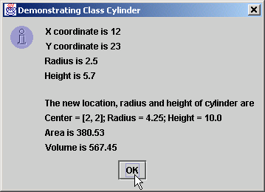
Fig. 9.15 Testing class Test

Slide 42
9.10 Introduction to Polymorphism
Polymorphism
  Helps build extensible systems
  Programs generically process objects as superclass objects
    Can add classes to systems easily
      Classes must be part of generically processed hierarchy

Slide 43
9.11 Type Fields and Switch Statements
switch-based system
  Determine appropriate action for object
    Based on object’s type
  Error prone
    Programmer can forget to make appropriate type test
    Adding and deleting switch statements

Slide 44
9.12 Dynamic Method Binding
Dynamic method binding
  Implements polymorphic processing of objects
  Use superclass reference to refer to subclass object
  Program chooses “correct” method in subclass

Slide 45
9.12 Dynamic Method Binding (cont.)
For example,
  Superclass Shape
  Subclasses Circle, Rectangle and Square
  Each class draws itself according to type of class
    Shape has method draw
    Each subclass overrides method draw
    Call method draw of superclass Shape
      Program determines dynamically which subclass draw method to invoke

Slide 46
9.13 final Methods and Classes
final method
  Cannot be overridden in subclass
final class
  Cannot be superclass (cannot be extended)
    Class cannot inherit final classes

Slide 47
9.14 Abstract Superclasses and Concrete Classes
Abstract classes
  Objects cannot be instantiated
  Too generic to define real objects
    TwoDimensionalShape
  Provides superclass from which other classes may inherit
    Normally referred to as abstract superclasses
Concrete classes
  Classes from which objects are instantiated
  Provide specifics for instantiating objects
    Square, Circle and Triangle

Slide 48
9.15 Polymorphism Examples
Video game
  Superclass GamePiece
    Contains method drawYourself
  Subclasses Martian, Venutian, LaserBeam, etc.
    Override method drawYourself
      Martian draws itself with antennae
      LaserBeam draws itself as bright red beam
      This is polymorphism
  Easily extensible
    Suppose we add class Mercurian
      Class Mercurian inherits superclass GamePiece
      Overrides method drawYourself

Slide 49
9.16 Case Study: A Payroll System Using Polymorphism
Abstract methods and polymorphism
  Abstract superclass Employee
    Method earnings applies to all employees
    Person’s earnings dependent on type of Employee
  Concrete Employee subclasses declared final
    Boss
    CommissionWorker
    PieceWorker
    HourlyWorker

Slide 50
Employee.java
Line 4 abstract class cannot be instantiated
Lines 5-6 and 16-30 abstract class can have instance data and nonabstract methods for subclasses
Lines 9-13 abstract class can have constructors for subclasses to initialize inherited data
1 // Fig. 9.16: Employee.java
2 // Abstract base class Employee.
3
4 public abstract class Employee {
5 private String firstName;
6 private String lastName;
7
8 // constructor
9 public Employee( String first, String last )
10 {
11 firstName = first;
12 lastName = last;
13 }
14
15 // get first name
16 public String getFirstName()
17 {
18 return firstName;
19 }
20
21 // get last name
22 public String getLastName()
23 {
24 return lastName;
25 }
26
27 public String toString()
28 {
29 return firstName + ' ' + lastName;
30 }
31
abstract class cannot be instantiated
abstract class can have instance data and nonabstract methods for subclasses
abstract class can have constructors for subclasses to initialize inherited data

Slide 51
Employee.java
Line 35
Subclasses must implement abstract method
32 // Abstract method that must be implemented for each
33 // derived class of Employee from which objects
34 // are instantiated.
35 public abstract double earnings();
36
37 } // end class Employee
Subclasses must implement abstract method

Slide 52
Boss.java
Line 4
Boss is an Employee subclass
Line 4
Boss inherits Employee’s public methods (except for constuctor)
Line 10
Explicit call to Employee constructor using super
Lines 21-24
Required to implement Employee’s method earnings (polymorphism)
1 // Fig. 9.17: Boss.java
2 // Boss class derived from Employee.
3
4 public final class Boss extends Employee {
5 private double weeklySalary;
6
7 // constructor for class Boss
8 public Boss( String first, String last, double salary )
9 {
10 super( first, last ); // call superclass constructor
11 setWeeklySalary( salary );
12 }
13
14 // set Boss's salary
15 public void setWeeklySalary( double salary )
16 {
17 weeklySalary = ( salary > 0 ? salary : 0 );
18 }
19
20 // get Boss's pay
21 public double earnings()
22 {
23 return weeklySalary;
24 }
25
26 // get String representation of Boss's name
27 public String toString()
28 {
29 return "Boss: " + super.toString();
30 }
31
32 } // end class Boss
Boss is an Employee subclass
Boss inherits Employee’s public methods (except for constuctor)
Explicit call to Employee constructor using super
Required to implement Employee’s method earnings (polymorphism)

Slide 53
CommissionWorker.java
Line 4
CommissionWorker is an Employee subclass
Line 13
Explicit call to Employee constructor using super
CommissionWorker is an Employee subclass
1 // Fig. 9.18: CommissionWorker.java
2 // CommissionWorker class derived from Employee
3
4 public final class CommissionWorker extends Employee {
5 private double salary; // base salary per week
6 private double commission; // amount per item sold
7 private int quantity; // total items sold for week
8
9 // constructor for class CommissionWorker
10 public CommissionWorker( String first, String last,
11 double salary, double commission, int quantity )
12 {
13 super( first, last ); // call superclass constructor
14 setSalary( salary );
15 setCommission( commission );
16 setQuantity( quantity );
17 }
18
19 // set CommissionWorker's weekly base salary
20 public void setSalary( double weeklySalary )
21 {
22 salary = ( weeklySalary > 0 ? weeklySalary : 0 );
23 }
24
25 // set CommissionWorker's commission
26 public void setCommission( double itemCommission )
27 {
28 commission = ( itemCommission > 0 ? itemCommission : 0 );
29 }
30
Explicit call to Employee constructor using super

Slide 54
CommissionWorker.java
Lines 38-41
Required to implement Employee’s method earnings; this implementation differs from that in Boss
31 // set CommissionWorker's quantity sold
32 public void setQuantity( int totalSold )
33 {
34 quantity = ( totalSold > 0 ? totalSold : 0 );
35 }
36
37 // determine CommissionWorker's earnings
38 public double earnings()
39 {
40 return salary + commission * quantity;
41 }
42
43 // get String representation of CommissionWorker's name
44 public String toString()
45 {
46 return "Commission worker: " + super.toString();
47 }
48
49 } // end class CommissionWorker
Required to implement Employee’s method earnings; this implementation differs from that in Boss

Slide 55
PieceWorker.java
Line 4
PieceWorker is an
Employee subclass
Line 12
Explicit call to Employee constructor using super
Lines 30-33 Implementation of Employee’s method earnings; differs from that of Boss and CommissionWorker
PieceWorker is an Employee subclass
1 // Fig. 9.19: PieceWorker.java
2 // PieceWorker class derived from Employee
3
4 public final class PieceWorker extends Employee {
5 private double wagePerPiece; // wage per piece output
6 private int quantity; // output for week
7
8 // constructor for class PieceWorker
9 public PieceWorker( String first, String last,
10 double wage, int numberOfItems )
11 {
12 super( first, last ); // call superclass constructor
13 setWage( wage );
14 setQuantity( numberOfItems);
15 }
16
17 // set PieceWorker's wage
18 public void setWage( double wage )
19 {
20 wagePerPiece = ( wage > 0 ? wage : 0 );
21 }
22
23 // set number of items output
24 public void setQuantity( int numberOfItems )
25 {
26 quantity = ( numberOfItems > 0 ? numberOfItems : 0 );
27 }
28
29 // determine PieceWorker's earnings
30 public double earnings()
31 {
32 return quantity * wagePerPiece;
33 }
34
Explicit call to Employee constructor using super
Implementation of Employee’s method earnings; differs from that of Boss and CommissionWorker

Slide 56
PieceWorker.java
35 public String toString()
36 {
37 return "Piece worker: " + super.toString();
38 }
39
40 } // end class PieceWorker

Slide 57
HourlyWorker.java
Line 4
PieceWorker is an
Employee subclass
Line 12
Explicit call to Employee constructor using super
Line 31
Implementation of Employee’s method earnings; differs from that of other Employee subclasses
HourlyWorker is an Employee subclass
1 // Fig. 9.20: HourlyWorker.java
2 // Definition of class HourlyWorker
3
4 public final class HourlyWorker extends Employee {
5 private double wage; // wage per hour
6 private double hours; // hours worked for week
7
8 // constructor for class HourlyWorker
9 public HourlyWorker( String first, String last,
10 double wagePerHour, double hoursWorked )
11 {
12 super( first, last ); // call superclass constructor
13 setWage( wagePerHour );
14 setHours( hoursWorked );
15 }
16
17 // Set the wage
18 public void setWage( double wagePerHour )
19 {
20 wage = ( wagePerHour > 0 ? wagePerHour : 0 );
21 }
22
23 // Set the hours worked
24 public void setHours( double hoursWorked )
25 {
26 hours = ( hoursWorked >= 0 && hoursWorked < 168 ?
27 hoursWorked : 0 );
28 }
29
30 // Get the HourlyWorker's pay
31 public double earnings() { return wage * hours; }
32
Explicit call to Employee constructor using super
Implementation of Employee’s method earnings; differs from that of other Employee subclasses

Slide 58
HourlyWorker.java
33 public String toString()
34 {
35 return "Hourly worker: " + super.toString();
36 }
37
38 } // end class HourlyWorker

Slide 59
Test.java
Line 15
Test cannot instantiate Employee but can reference one
Lines 18-28
Instantiate one instance each of Employee subclasses
1 // Fig. 9.21: Test.java
2 // Driver for Employee hierarchy
3
4 // Java core packages
5 import java.text.DecimalFormat;
6
7 // Java extension packages
8 import javax.swing.JOptionPane;
9
10 public class Test {
11
12 // test Employee hierarchy
13 public static void main( String args[] )
14 {
15 Employee employee; // superclass reference
16 String output = "";
17
18 Boss boss = new Boss( "John", "Smith", 800.0 );
19
20 CommissionWorker commisionWorker =
21 new CommissionWorker(
22 "Sue", "Jones", 400.0, 3.0, 150 );
23
24 PieceWorker pieceWorker =
25 new PieceWorker( "Bob", "Lewis", 2.5, 200 );
26
27 HourlyWorker hourlyWorker =
28 new HourlyWorker( "Karen", "Price", 13.75, 40 );
29
30 DecimalFormat precision2 = new DecimalFormat( "0.00" );
31
Test cannot instantiate Employee but can reference one
Instantiate one instance each of Employee subclasses

Slide 60
Test.java
Line 33
Use Employee to reference Boss
Line 36
Method employee.earnings dynamically binds to method boss.earnings
Lines 41-55
Do same for CommissionWorker and PieceWorker
Use Employee to reference Boss
32 // Employee reference to a Boss
33 employee = boss;
34
35 output += employee.toString() + " earned $" +
36 precision2.format( employee.earnings() ) + "\n" +
37 boss.toString() + " earned $" +
38 precision2.format( boss.earnings() ) + "\n";
39
40 // Employee reference to a CommissionWorker
41 employee = commissionWorker;
42
43 output += employee.toString() + " earned $" +
44 precision2.format( employee.earnings() ) + "\n" +
45 commissionWorker.toString() + " earned $" +
46 precision2.format(
47 commissionWorker.earnings() ) + "\n";
48
49 // Employee reference to a PieceWorker
50 employee = pieceWorker;
51
52 output += employee.toString() + " earned $" +
53 precision2.format( employee.earnings() ) + "\n" +
54 pieceWorker.toString() + " earned $" +
55 precision2.format( pieceWorker.earnings() ) + "\n";
56
Method employee.earnings dynamically binds to method boss.earnings
Do same for CommissionWorker and PieceWorker

Slide 61
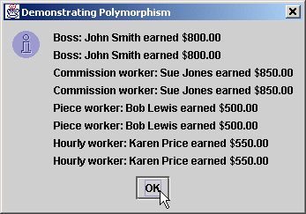
Test.java
Lines 58-63
Repeat for HourlyWorker
57 // Employee reference to an HourlyWorker
58 employee = hourlyWorker;
59
60 output += employee.toString() + " earned $" +
61 precision2.format( employee.earnings() ) + "\n" +
62 hourlyWorker.toString() + " earned $" +
63 precision2.format( hourlyWorker.earnings() ) + "\n";
64
65 JOptionPane.showMessageDialog( null, output,
66 "Demonstrating Polymorphism",
67 JOptionPane.INFORMATION_MESSAGE );
68
69 System.exit( 0 );
70 }
71
72 } // end class Test
Repeat for HourlyWorker

Slide 62
9.17 New Classes and Dynamic Binding
Dynamic binding (late binding)
  Object’s type need not be know at compile time
  At run time, call is matched with method of called object

Slide 63
9.18 Case Study: Inheriting Interface and Implementation
Point, Circle, Cylinder hierarchy
  Modify by including abstract superclass Shape
    Demonstrates polymorphism
    Contains abstract method getName
      Each subclass must implement method getName
    Contains (nonabstract) methods area and volume
      Return 0 by default
      Each subclass overrides these methods

Slide 64
Shape.java
Line 4
Shape cannot be instantiated
Lines 7-16 abstract class can have nonabstract methods for subclasses
Line 20
Concrete subclasses must implement method getName
1 // Fig. 9.22: Shape.java
2 // Definition of abstract base class Shape
3
4 public abstract class Shape extends Object {
5
6 // return shape's area
7 public double area()
8 {
9 return 0.0;
10 }
11
12 // return shape's volume
13 public double volume()
14 {
15 return 0.0;
16 }
17
18 // abstract method must be defined by concrete subclasses
19 // to return appropriate shape name
20 public abstract String getName();
21
22 } // end class Shape
Shape cannot be instantiated
abstract class can have nonabstract methods for subclasses
Concrete subclasses must implement method getName

Slide 65
Point.java
Line 4
Point inherits Shape’s public methods
Line 5 protected members prevent clients from direct access (unless clients are Point subclasses or are in same package)
Point inherits Shape’s public methods
1 // Fig. 9.23: Point.java
2 // Definition of class Point
3
4 public class Point extends Shape {
5 protected int x, y; // coordinates of the Point
6
7 // no-argument constructor
8 public Point()
9 {
10 setPoint( 0, 0 );
11 }
12
13 // constructor
14 public Point( int xCoordinate, int yCoordinate )
15 {
16 setPoint( xCoordinate, yCoordinate );
17 }
18
19 // set x and y coordinates of Point
20 public void setPoint( int xCoordinate, int yCoordinate )
21 {
22 x = xCoordinate;
23 y = yCoordinate;
24 }
25
26 // get x coordinate
27 public int getX()
28 {
29 return x;
30 }
31
protected members prevent clients from direct access (unless clients are Point subclasses or are in same package)

Slide 66
Point.java
Lines 45-48
Implementation of Shape’s method getName
*** Note ***
32 // get y coordinate
33 public int getY()
34 {
35 return y;
36 }
37
38 // convert point into String representation
39 public String toString()
40 {
41 return "[" + x + ", " + y + "]";
42 }
43
44 // return shape name
45 public String getName()
46 {
47 return "Point";
48 }
49
50 } // end class Point
Implementation of Shape’s method getName
Point does not override methods area and volume, because points have neither area nor volume

Slide 67
Circle.java
Line 4
Circle inherits variables/methods from Point and Shape
Lines 5 and 24-34
Methods for reading/setting protected value
Circle inherits variables/methods from Point and Shape
1 // Fig. 9.24: Circle.java
2 // Definition of class Circle
3
4 public class Circle extends Point { // inherits from Point
5 protected double radius;
6
7 // no-argument constructor
8 public Circle()
9 {
10 // implicit call to superclass constructor here
11 setRadius( 0 );
12 }
13
14 // constructor
15 public Circle( double circleRadius, int xCoordinate,
16 int yCoordinate )
17 {
18 // call superclass constructor
19 super( xCoordinate, yCoordinate );
20
21 setRadius( circleRadius );
22 }
23
24 // set radius of Circle
25 public void setRadius( double circleRadius )
26 {
27 radius = ( circleRadius >= 0 ? circleRadius : 0 );
28 }
29
30 // get radius of Circle
31 public double getRadius()
32 {
33 return radius;
34 }
35
Methods for reading/setting protected value

Slide 68
Circle.java
Lines 37-40
Override method area but not method volume (circles do not have volume)
Lines 50-53
Implementation of Shape’s method getName
36 // calculate area of Circle
37 public double area()
38 {
39 return Math.PI * radius * radius;
40 }
41
42 // convert Circle to a String represention
43 public String toString()
44 {
45 return "Center = " + super.toString() +
46 "; Radius = " + radius;
47 }
48
49 // return shape name
50 public String getName()
51 {
52 return "Circle";
53 }
54
55 } // end class Circle
Override method area but not method volume (circles do not have volume)
Implementation of Shape’s method getName

Slide 69
Cylinder.java
Line 4
Cylinder inherits variables and methods from Point, Circle and Shape
Cylinder inherits variables and methods from Point, Circle and Shape
1 // Fig. 9.25: Cylinder.java
2 // Definition of class Cylinder.
3
4 public class Cylinder extends Circle {
5 protected double height; // height of Cylinder
6
7 // no-argument constructor
8 public Cylinder()
9 {
10 // implicit call to superclass constructor here
11 setHeight( 0 );
12 }
13
14 // constructor
15 public Cylinder( double cylinderHeight,
16 double cylinderRadius, int xCoordinate,
17 int yCoordinate )
18 {
19 // call superclass constructor
20 super( cylinderRadius, xCoordinate, yCoordinate );
21
22 setHeight( cylinderHeight );
23 }
24
25 // set height of Cylinder
26 public void setHeight( double cylinderHeight )
27 {
28 height = ( cylinderHeight >= 0 ? cylinderHeight : 0 );
29 }
30

Slide 70
Cylinder.java
Lines 38-47
Override methods area and volume
Lines 56-59 Implementation of Shape’s method getName
31 // get height of Cylinder
32 public double getHeight()
33 {
34 return height;
35 }
36
37 // calculate area of Cylinder (i.e., surface area)
38 public double area()
39 {
40 return 2 * super.area() + 2 * Math.PI * radius * height;
41 }
42
43 // calculate volume of Cylinder
44 public double volume()
45 {
46 return super.area() * height;
47 }
48
49 // convert Cylinder to a String representation
50 public String toString()
51 {
52 return super.toString() + "; Height = " + height;
53 }
54
55 // return shape name
56 public String getName()
57 {
58 return "Cylinder";
59 }
60
61 } // end class Cylinder
Override methods area and volume
Implementation of Shape’s method getName

Slide 71
Test.java
Lines 16-18
Instantiate one instance each of Shape subclasses
Lines 21-30
Create three Shapes to reference each subclass object
1 // Fig. 9.26: Test.java
2 // Class to test Shape, Point, Circle, Cylinder hierarchy
3
4 // Java core packages
5 import java.text.DecimalFormat;
6
7 // Java extension packages
8 import javax.swing.JOptionPane;
9
10 public class Test {
11
12 // test Shape hierarchy
13 public static void main( String args[] )
14 {
15 // create shapes
16 Point point = new Point( 7, 11 );
17 Circle circle = new Circle( 3.5, 22, 8 );
18 Cylinder cylinder = new Cylinder( 10, 3.3, 10, 10 );
19
20 // create Shape array
21 Shape arrayOfShapes[] = new Shape[ 3 ];
22
23 // aim arrayOfShapes[ 0 ] at subclass Point object
24 arrayOfShapes[ 0 ] = point;
25
26 // aim arrayOfShapes[ 1 ] at subclass Circle object
27 arrayOfShapes[ 1 ] = circle;
28
29 // aim arrayOfShapes[ 2 ] at subclass Cylinder object
30 arrayOfShapes[ 2 ] = cylinder;
31
Instantiate one instance each of Shape subclasses
Create three Shapes to reference each subclass object

Slide 72
Test.java
Line 43
Dynamically bind method getName
Line 46
Dynamically bind method area for Circle and Cylinder objects
Line 48
Dynamically bind method volume for Cylinder object
32 // get name and String representation of each shape
33 String output =
34 point.getName() + ": " + point.toString() + "\n" +
35 circle.getName() + ": " + circle.toString() + "\n" +
36 cylinder.getName() + ": " + cylinder.toString();
37
38 DecimalFormat precision2 = new DecimalFormat( "0.00" );
39
40 // loop through arrayOfShapes and get name,
41 // area and volume of each shape in arrayOfShapes
42 for ( int i = 0; i < arrayOfShapes.length; i++ ) {
43 output += "\n\n" + arrayOfShapes[ i ].getName() +
44 ": " + arrayOfShapes[ i ].toString() +
45 "\nArea = " +
46 precision2.format( arrayOfShapes[ i ].area() ) +
47 "\nVolume = " +
48 precision2.format( arrayOfShapes[ i ].volume() );
49 }
50
51 JOptionPane.showMessageDialog( null, output,
52 "Demonstrating Polymorphism",
53 JOptionPane.INFORMATION_MESSAGE );
54
55 System.exit( 0 );
56 }
57
58 } // end class Test
Dynamically bind method getName
Dynamically bind method area for Circle and Cylinder objects
Dynamically bind method volume for Cylinder object

Slide 73
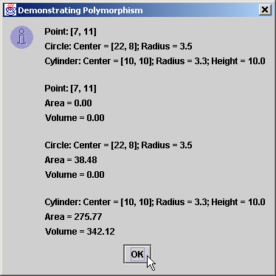
Test.java

Slide 74
9.19 Case Study: Creating and Using Interfaces
Use interface Shape
  Replace abstract class Shape
Interface
  Definition begins with interface keyword
  Classes implement an interface (and its methods)
  Contains public abstract methods
    Classes (that implement the interface) must implement these methods

Slide 75
Shape.java
Lines 7-13
Classes that implement Shape must implement these methods
1 // Fig. 9.27: Shape.java
2 // Definition of interface Shape
3
4 public interface Shape {
5
6 // calculate area
7 public abstract double area();
8
9 // calculate volume
10 public abstract double volume();
11
12 // return shape name
13 public abstract String getName();
14 }
Classes that implement Shape must implement these methods

Slide 76
Point.java
Line 4
Point implements interface Shape
1 // Fig. 9.28: Point.java
2 // Definition of class Point
3
4 public class Point extends Object implements Shape {
5 protected int x, y; // coordinates of the Point
6
7 // no-argument constructor
8 public Point()
9 {
10 setPoint( 0, 0 );
11 }
12
13 // constructor
14 public Point( int xCoordinate, int yCoordinate )
15 {
16 setPoint( xCoordinate, yCoordinate );
17 }
18
19 // Set x and y coordinates of Point
20 public void setPoint( int xCoordinate, int yCoordinate )
21 {
22 x = xCoordinate;
23 y = yCoordinate;
24 }
25
26 // get x coordinate
27 public int getX()
28 {
29 return x;
30 }
31
Point implements interface Shape

Slide 77
Point.java
Lines 45-60
Implement methods specified by interface Shape
32 // get y coordinate
33 public int getY()
34 {
35 return y;
36 }
37
38 // convert point into String representation
39 public String toString()
40 {
41 return "[" + x + ", " + y + "]";
42 }
43
44 // calculate area
45 public double area()
46 {
47 return 0.0;
48 }
49
50 // calculate volume
51 public double volume()
52 {
53 return 0.0;
54 }
55
56 // return shape name
57 public String getName()
58 {
59 return "Point";
60 }
61
62 } // end class Point
Implement methods specified by interface Shape

Slide 78
Circle.java
Line 4
Circle inherits variables/methods from Point, including method implemen-tations of Shape
1 // Fig. 9.29: Circle.java
2 // Definition of class Circle
3
4 public class Circle extends Point { // inherits from Point
5 protected double radius;
6
7 // no-argument constructor
8 public Circle()
9 {
10 // implicit call to superclass constructor here
11 setRadius( 0 );
12 }
13
14 // constructor
15 public Circle( double circleRadius, int xCoordinate,
16 int yCoordinate )
17 {
18 // call superclass constructor
19 super( xCoordinate, yCoordinate );
20
21 setRadius( circleRadius );
22 }
23
24 // set radius of Circle
25 public void setRadius( double circleRadius )
26 {
27 radius = ( circleRadius >= 0 ? circleRadius : 0 );
28 }
29
30 // get radius of Circle
31 public double getRadius()
32 {
33 return radius;
34 }
35
Circle inherits variables/methods from Point, including method implementations of Shape

Slide 79
Circle.java
Lines 43-47
Override method toString
Lines 37-40 and 50-53 Override methods area and getName but not method volume
36 // calculate area of Circle
37 public double area()
38 {
39 return Math.PI * radius * radius;
40 }
41
42 // convert Circle to a String represention
43 public String toString()
44 {
45 return "Center = " + super.toString() +
46 "; Radius = " + radius;
47 }
48
49 // return shape name
50 public String getName()
51 {
52 return "Circle";
53 }
54
55 } // end class Circle
Override method toString
Override methods area and getName but not method volume

Slide 80
Cylinder.java
Line 4
Circle inherits variables/methods from Point and Circle and method implementations of Shape
1 // Fig. 9.30: Cylinder.java
2 // Definition of class Cylinder.
3
4 public class Cylinder extends Circle {
5 protected double height; // height of Cylinder
6
7 // no-argument constructor
8 public Cylinder()
9 {
10 // implicit call to superclass constructor here
11 setHeight( 0 );
12 }
13
14 // constructor
15 public Cylinder( double cylinderHeight,
16 double cylinderRadius, int xCoordinate,
17 int yCoordinate )
18 {
19 // call superclass constructor
20 super( cylinderRadius, xCoordinate, yCoordinate );
21
22 setHeight( cylinderHeight );
23 }
24
25 // set height of Cylinder
26 public void setHeight( double cylinderHeight )
27 {
28 height = ( cylinderHeight >= 0 ? cylinderHeight : 0 );
29 }
30
31 // get height of Cylinder
32 public double getHeight()
33 {
34 return height;
35 }
Circle inherits variables/methods from Point and Circle and method implementations of Shape

Slide 81
Cylinder.java
Lines 50-53
Override method toString
Line 38-59
Override methods area, volume and getName
36
37 // calculate area of Cylinder (i.e., surface area)
38 public double area()
39 {
40 return 2 * super.area() + 2 * Math.PI * radius * height;
41 }
42
43 // calculate volume of Cylinder
44 public double volume()
45 {
46 return super.area() * height;
47 }
48
49 // convert Cylinder to a String representation
50 public String toString()
51 {
52 return super.toString() + "; Height = " + height;
53 }
54
55 // return shape name
56 public String getName()
57 {
58 return "Cylinder";
59 }
60
61 } // end class Cylinder
Override method toString
Override methods area, volume and getName

Slide 82
Test.java
Fig. 9.31 is identical to Fig. 9.26
1 // Fig. 9.31: Test.java
2 // Test Point, Circle, Cylinder hierarchy with interface Shape.
3
4 // Java core packages
5 import java.text.DecimalFormat;
6
7 // Java extension packages
8 import javax.swing.JOptionPane;
9
10 public class Test {
11
12 // test Shape hierarchy
13 public static void main( String args[] )
14 {
15 // create shapes
16 Point point = new Point( 7, 11 );
17 Circle circle = new Circle( 3.5, 22, 8 );
18 Cylinder cylinder = new Cylinder( 10, 3.3, 10, 10 );
19
20 // create Shape array
21 Shape arrayOfShapes[] = new Shape[ 3 ];
22
23 // aim arrayOfShapes[ 0 ] at subclass Point object
24 arrayOfShapes[ 0 ] = point;
25
26 // aim arrayOfShapes[ 1 ] at subclass Circle object
27 arrayOfShapes[ 1 ] = circle;
28
29 // aim arrayOfShapes[ 2 ] at subclass Cylinder object
30 arrayOfShapes[ 2 ] = cylinder;
31
Fig. 9.31 is identical to Fig. 9.26

Slide 83
Test.java
32 // get name and String representation of each shape
33 String output =
34 point.getName() + ": " + point.toString() + "\n" +
35 circle.getName() + ": " + circle.toString() + "\n" +
36 cylinder.getName() + ": " + cylinder.toString();
37
38 DecimalFormat precision2 = new DecimalFormat( "0.00" );
39
40 // loop through arrayOfShapes and get name,
41 // area and volume of each shape in arrayOfShapes
42 for ( int i = 0; i < arrayOfShapes.length; i++ ) {
43 output += "\n\n" + arrayOfShapes[ i ].getName() +
44 ": " + arrayOfShapes[ i ].toString() +
45 "\nArea = " +
46 precision2.format( arrayOfShapes[ i ].area() ) +
47 "\nVolume = " +
48 precision2.format( arrayOfShapes[ i ].volume() );
49 }
50
51 JOptionPane.showMessageDialog( null, output,
52 "Demonstrating Polymorphism",
53 JOptionPane.INFORMATION_MESSAGE );
54
55 System.exit( 0 );
56 }
57
58 } // end class Test

Slide 84

Test.java
Output is identical to that of Fig. 9.26
Output is identical to that of Fig. 9.26

Slide 85
9.20 Inner Class Definitions
Inner classes
  Class is defined inside another class body
  Frequently used with GUI handling
    Declare ActionListener inner class
    GUI components can register ActionListeners for events
      Button events, key events, etc.

Slide 86
Time.java
Line 8
Same Time class used in Chapter 8
1 // Fig. 9.32: Time.java
2 // Time class definition.
3
4 // Java core packages
5 import java.text.DecimalFormat;
6
7 // This class maintains the time in 24-hour format
8 public class Time extends Object {
9 private int hour; // 0 - 23
10 private int minute; // 0 - 59
11 private int second; // 0 - 59
12
13 // Time constructor initializes each instance variable
14 // to zero. Ensures that Time object starts in a
15 // consistent state.
16 public Time()
17 {
18 setTime( 0, 0, 0 );
19 }
20
21 // Set a new time value using universal time. Perform
22 // validity checks on the data. Set invalid values to zero.
23 public void setTime( int hour, int minute, int second )
24 {
25 setHour( hour );
26 setMinute( minute );
27 setSecond( second );
28 }
29
30 // validate and set hour
31 public void setHour( int h )
32 {
33 hour = ( ( h >= 0 && h < 24 ) ? h : 0 );
34 }
35
Same Time class used in Chapter 8

Slide 87
Time.java
Mutator and accessor methods
36 // validate and set minute
37 public void setMinute( int m )
38 {
39 minute = ( ( m >= 0 && m < 60 ) ? m : 0 );
40 }
41
42 // validate and set second
43 public void setSecond( int s )
44 {
45 second = ( ( s >= 0 && s < 60 ) ? s : 0 );
46 }
47
48 // get hour
49 public int getHour()
50 {
51 return hour;
52 }
53
54 // get minute
55 public int getMinute()
56 {
57 return minute;
58 }
59
60 // get second
61 public int getSecond()
62 {
63 return second;
64 }
65
Mutator and accessor methods

Slide 88
Time.java
Lines 67-76
Override method java.lang.Object.toString
66 // convert to String in standard-time format
67 public String toString()
68 {
69 DecimalFormat twoDigits = new DecimalFormat( "00" );
70
71 return ( ( getHour() == 12 || getHour() == 0 ) ?
72 12 : getHour() % 12 ) + ":" +
73 twoDigits.format( getMinute() ) + ":" +
74 twoDigits.format( getSecond() ) +
75 ( getHour() < 12 ? " AM" : " PM" );
76 }
77
78 } // end class Time
Override method java.lang.Object.toString

Slide 89
TimeTestWindow.java
Line 11
JFrame provides basic window attributes and behaviors
Line 19
JFrame (unlike JApplet) has constructor
Line 23
Instantiate Time object
Line 26
Instantiate object of inner-class that implements ActionListener
1 // Fig. 9.33: TimeTestWindow.java
2 // Demonstrating the Time class set and get methods
3
4 // Java core packages
5 import java.awt.*;
6 import java.awt.event.*;
7
8 // Java extension packages
9 import javax.swing.*;
10
11 public class TimeTestWindow extends JFrame {
12 private Time time;
13 private JLabel hourLabel, minuteLabel, secondLabel;
14 private JTextField hourField, minuteField,
15 secondField, displayField;
16 private JButton exitButton;
17
18 // set up GUI
19 public TimeTestWindow()
20 {
21 super( "Inner Class Demonstration" );
22
23 time = new Time();
24
25 // create an instance of inner class ActionEventHandler
26 ActionEventHandler handler = new ActionEventHandler();
27
28 // set up GUI
29 Container container = getContentPane();
30 container.setLayout( new FlowLayout() );
31
JFrame provides basic window attributes and behaviors
JFrame (unlike JApplet) has constructor
Instantiate Time object
Instantiate object of inner-class that implements ActionListener

Slide 90
TimeTestWindow.java
Line 34, 40, 46 and 55 Register Action-EventHandler with GUI components
32 hourLabel = new JLabel( "Set Hour" );
33 hourField = new JTextField( 10 );
34 hourField.addActionListener( handler );
35 container.add( hourLabel );
36 container.add( hourField );
37
38 minuteLabel = new JLabel( "Set minute" );
39 minuteField = new JTextField( 10 );
40 minuteField.addActionListener( handler );
41 container.add( minuteLabel );
42 container.add( minuteField );
43
44 secondLabel = new JLabel( "Set Second" );
45 secondField = new JTextField( 10 );
46 secondField.addActionListener( handler );
47 container.add( secondLabel );
48 container.add( secondField );
49
50 displayField = new JTextField( 30 );
51 displayField.setEditable( false );
52 container.add( displayField );
53
54 exitButton = new JButton( "Exit" );
55 exitButton.addActionListener( handler );
56 container.add( exitButton );
57
58 } // end constructor
59
60 // display time in displayField
61 public void displayTime()
62 {
63 displayField.setText( "The time is: " + time );
64 }
65
Register ActionEventHandler with GUI components

Slide 91
TimeTestWindow.java
Lines 77-78
Define inner class
Line 81
Must implement method actionPerformed
Line 81
When user presses button or key, method actionPerformed is invoked
Lines 84-99
Determine action depending on where event originated
66 // create TimeTestWindow and display it
67 public static void main( String args[] )
68 {
69 TimeTestWindow window = new TimeTestWindow();
70
71 window.setSize( 400, 140 );
72 window.setVisible( true );
73 }
74
75 // inner class definition for handling JTextField and
76 // JButton events
77 private class ActionEventHandler
78 implements ActionListener {
79
80 // method to handle action events
81 public void actionPerformed( ActionEvent event )
82 {
83 // user pressed exitButton
84 if ( event.getSource() == exitButton )
85 System.exit( 0 ); // terminate the application
86
87 // user pressed Enter key in hourField
88 else if ( event.getSource() == hourField ) {
89 time.setHour(
90 Integer.parseInt( event.getActionCommand() ) );
91 hourField.setText( "" );
92 }
93
94 // user pressed Enter key in minuteField
95 else if ( event.getSource() == minuteField ) {
96 time.setMinute(
97 Integer.parseInt( event.getActionCommand() ) );
98 minuteField.setText( "" );
99 }
Define inner class that implements ActionListener interface
Must implement method actionPerformed of ActionListener
When user presses JButton or Enter key, method actionPerformed is invoked
Determine action depending on where event originated

Slide 92
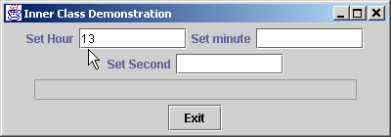
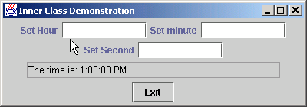
TimeTestWindow.java
100
101 // user pressed Enter key in secondField
102 else if ( event.getSource() == secondField ) {
103 time.setSecond(
104 Integer.parseInt( event.getActionCommand() ) );
105 secondField.setText( "" );
106 }
107
108 displayTime();
109 }
110
111 } // end inner class ActionEventHandler
112
113 } // end class TimeTestWindow

Slide 93
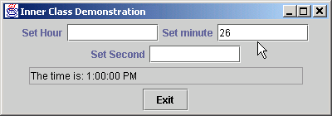

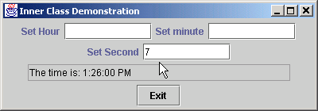

TimeTestWindow.java

Slide 94
9.20 Inner Class Definitions (cont.)
Anonymous inner class
  Inner class without name
  Created when class is defined in program

Slide 95
TimeTestWindow.java
1 // Fig. 9.34: TimeTestWindow.java
2 // Demonstrating the Time class set and get methods
3
4 // Java core packages
5 import java.awt.*;
6 import java.awt.event.*;
7
8 // Java extension packages
9 import javax.swing.*;
10
11 public class TimeTestWindow extends JFrame {
12 private Time time;
13 private JLabel hourLabel, minuteLabel, secondLabel;
14 private JTextField hourField, minuteField,
15 secondField, displayField;
16
17 // set up GUI
18 public TimeTestWindow()
19 {
20 super( "Inner Class Demonstration" );
21
22 // create Time object
23 time = new Time();
24
25 // create GUI
26 Container container = getContentPane();
27 container.setLayout( new FlowLayout() );
28
29 hourLabel = new JLabel( "Set Hour" );
30 hourField = new JTextField( 10 );
31

Slide 96
TimeTestWindow.java
Line 36
Define anonymous inner class
Lines 38-44
Inner class implements method actionPerformed
Line 33
Pass Action-Listener to GUI component’s method addAction-Listener
Line 57-60
Repeat process for minuteField
32 // register hourField event handler
33 hourField.addActionListener(
34
35 // anonymous inner class
36 new ActionListener() {
37
38 public void actionPerformed( ActionEvent event )
39 {
40 time.setHour(
41 Integer.parseInt( event.getActionCommand() ) );
42 hourField.setText( "" );
43 displayTime();
44 }
45
46 } // end anonymous inner class
47
48 ); // end call to addActionListener
49
50 container.add( hourLabel );
51 container.add( hourField );
52
53 minuteLabel = new JLabel( "Set minute" );
54 minuteField = new JTextField( 10 );
55
56 // register minuteField event handler
57 minuteField.addActionListener(
58
59 // anonymous inner class
60 new ActionListener() {
61
Define anonymous inner class that implements ActionListener
Inner class implements method actionPerformed of ActionListener
Pass ActionListener as argument to GUI component’s method addActionListener
Repeat process for JTextField minuteField

Slide 97
TimeTestWindow.java
Line 64-67
Logic differs from logic in action-Performed method of hourField’s inner class
Line 80-83
Repeat process for JTextField secondField
Line 87-90
Logic differs from logic in action-Performed methods of other inner classes
62 public void actionPerformed( ActionEvent event )
63 {
64 time.setMinute(
65 Integer.parseInt( event.getActionCommand() ) );
66 minuteField.setText( "" );
67 displayTime();
68 }
69
70 } // end anonymous inner class
71
72 ); // end call to addActionListener
73
74 container.add( minuteLabel );
75 container.add( minuteField );
76
77 secondLabel = new JLabel( "Set Second" );
78 secondField = new JTextField( 10 );
79
80 secondField.addActionListener(
81
82 // anonymous inner class
83 new ActionListener() {
84
85 public void actionPerformed( ActionEvent event )
86 {
87 time.setSecond(
88 Integer.parseInt( event.getActionCommand() ) );
89 secondField.setText( "" );
90 displayTime();
91 }
92
93 } // end anonymous inner class
94
95 ); // end call to addActionListener
96
Logic differs from logic in actionPerformed method of hourField’s inner class
Repeat process for JTextField secondField
Logic differs from logic in actionPerformed methods of other inner classes

Slide 98
TimeTestWindow.java
Line 118-131
Define anonymous inner class that extends WindowsAdapter to enable closing of JFrame
97 container.add( secondLabel );
98 container.add( secondField );
99
100 displayField = new JTextField( 30 );
101 displayField.setEditable( false );
102 container.add( displayField );
103 }
104
105 // display time in displayField
106 public void displayTime()
107 {
108 displayField.setText( "The time is: " + time );
109 }
110
111 // create TimeTestWindow, register for its window events
112 // and display it to begin application's execution
113 public static void main( String args[] )
114 {
115 TimeTestWindow window = new TimeTestWindow();
116
117 // register listener for windowClosing event
118 window.addWindowListener(
119
120 // anonymous inner class for windowClosing event
121 new WindowAdapter() {
122
123 // terminate application when user closes window
124 public void windowClosing( WindowEvent event )
125 {
126 System.exit( 0 );
127 }
128
129 } // end anonymous inner class
130
131 ); // end call to addWindowListener
Define anonymous inner class that extends WindowsAdapter to enable closing of JFrame

Slide 99
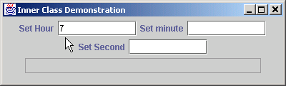
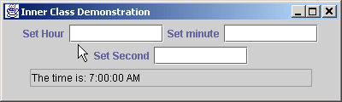
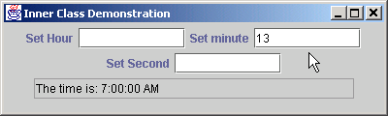

TimeTestWindow.java
132
133 window.setSize( 400, 120 );
134 window.setVisible( true );
135 }
136
137 } // end class TimeTestWindow

Slide 100
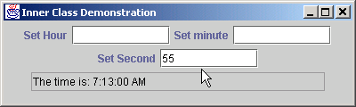
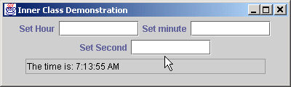
TimeTestWindow.java

Slide 101
9.21 Notes on Inner Class Definitions
Notes for inner-class definition and use
  Compiling class that contains inner class
    Results in separate .class file
  Inner classes with class names
    public, protected, private or package access
  Access outer class’ this reference
    OuterClassName.this
  Outer class is responsible for creating inner class objects
  Inner classes can be declared static

Slide 102
9.22 Type-Wrapper Classes for Primitive Types
Type-wrapper class
  Each primitive type has one
    Character, Byte, Integer, Boolean, etc.
  Enable to represent primitive as Object
    Primitive data types can be processed polymorphically
  Declared as final
  Many methods are declared static

